Slide 1
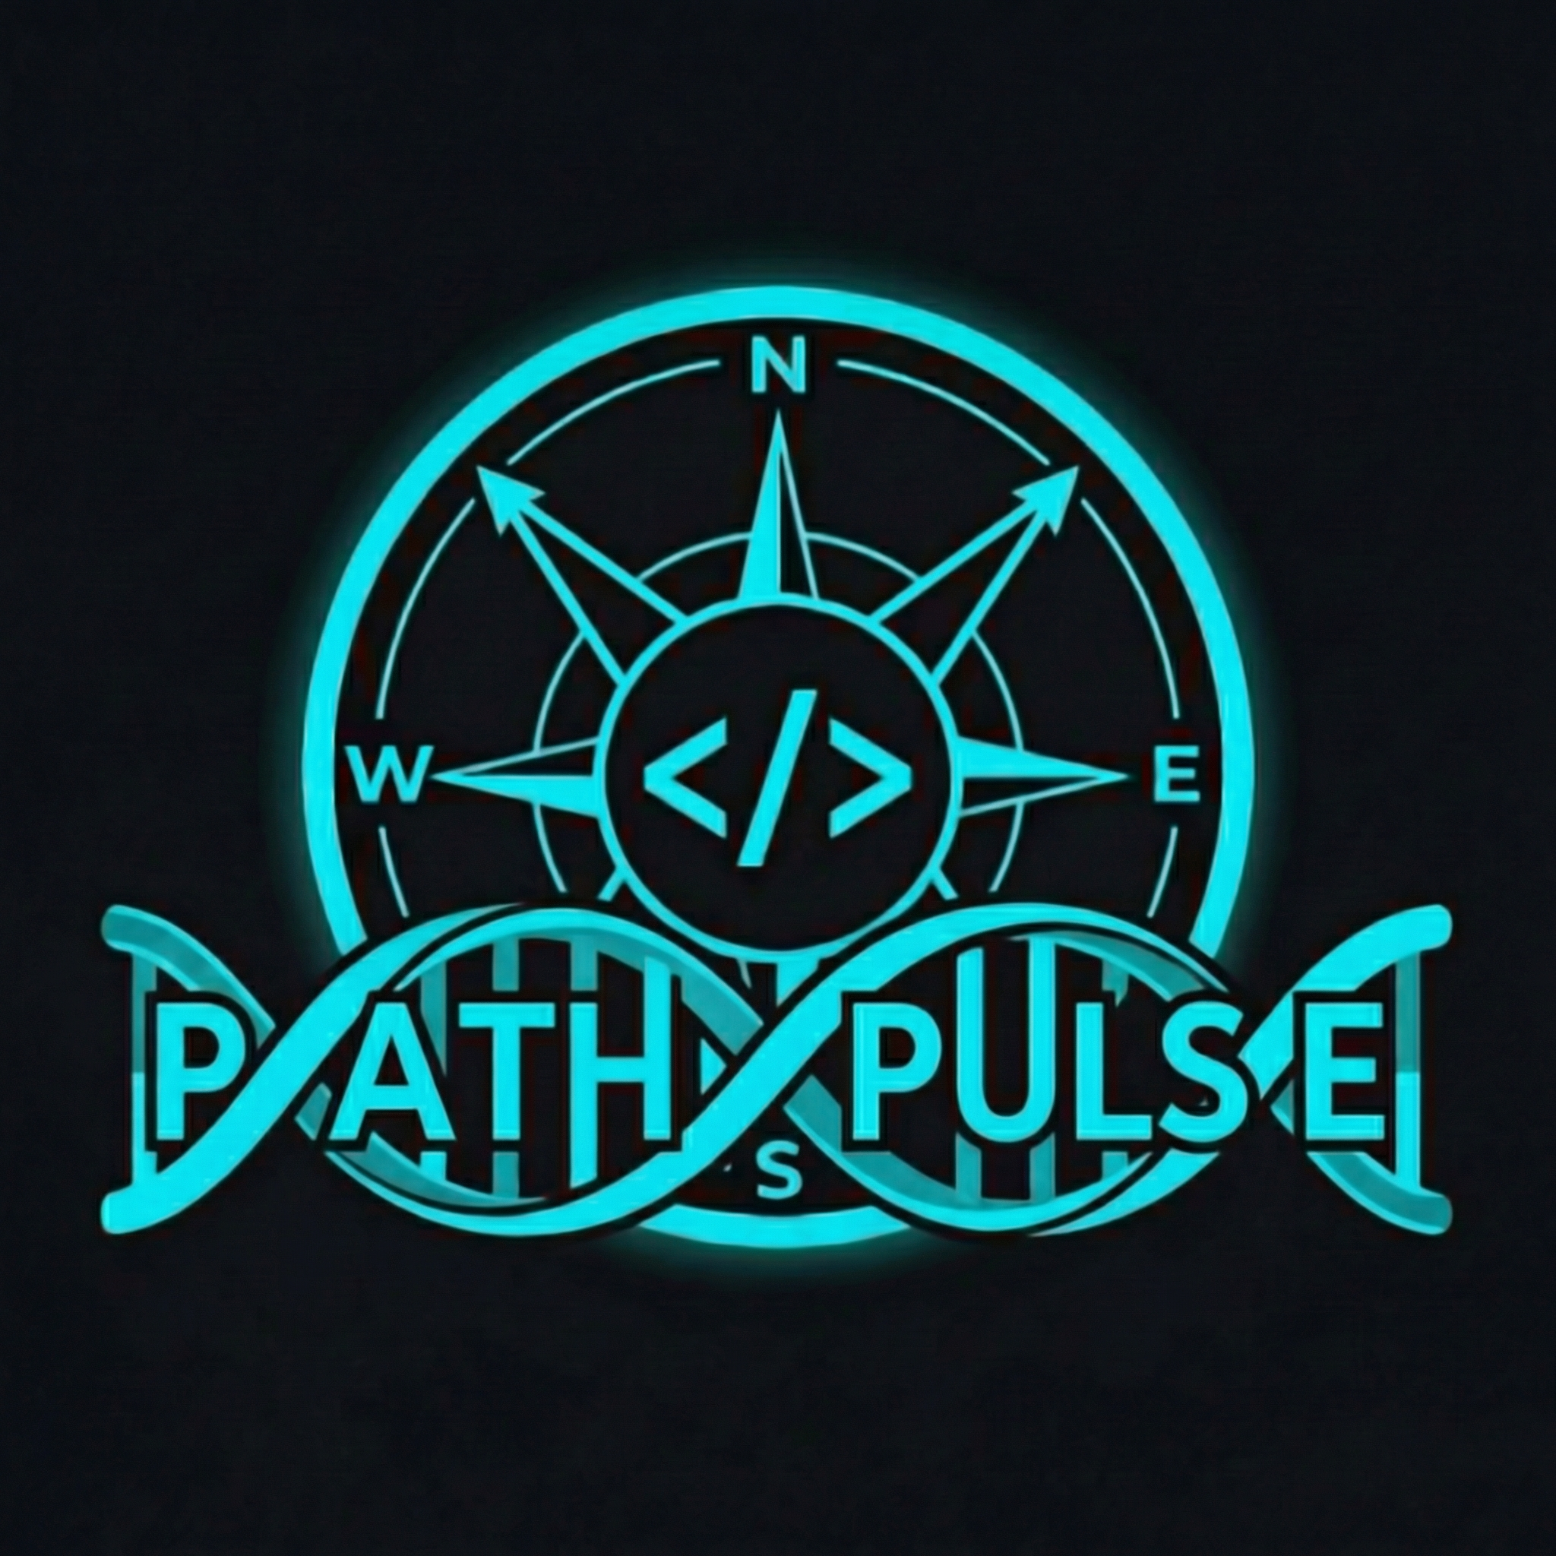
TACTICAL BIO-LAB
PATH-PULSE
Turn every walk into a mission. GPS routes, metabolic diagnostics, fuel tracking, and Ghost-Path racing—in your browser, Obsidian Lab aesthetic.
1 / 5

Slide 2
SUMMARY
What is Path-Pulse?
THE PRODUCT
A progressive web app that treats movement like tactical data: map expeditions, log fuel & steps, track BMI and weekly missions—without an app store install.
THE EXPERIENCE
Explorer's Oath → PRISM welcome → Home, Map, Report, Profile. Neon cyan & lime on obsidian—built for clarity and shareable lab vibes.
2 / 5

Slide 3
FEATURES (1/2)
Core capabilities
◆ Map & expedition: Live GPS route, distance HUD, route replay & Ghost-Path.
◆ Home & missions: Kinetic step ring, weekly mission, explorer level & rank.
◆ PRISM: Onboard welcome after the Oath; optional TTS and haptics.
◆ Report & share: Weekly diagnostic, calories, share text or report image.
3 / 5

Slide 4
FEATURES (2/2)
Health & data
◆ Profile & lab: BMI, BMR, TDEE, body composition (Navy optional), progress calendar.
◆ Fuel gauge: Meals with timestamps, balance vs target, calorie→weight estimate.
◆ Your data: On-device storage, export JSON, PWA & offline map tiles.
◆ Accessibility: ARIA labels, keyboard nav, reduced-motion support.
4 / 5

Slide 5
INITIALIZE THE GRID
Thank you
Open Path-Pulse in the browser, accept the Oath, and start your first expedition. Serve over HTTPS or localhost for GPS.
5 / 5

